Slide 1
Quiet and Safe: Finding the Best Zip Code
By William Cole

Slide 2
Parameters:
Low Noise Complaints
Low Reported Crimes

Slide 3
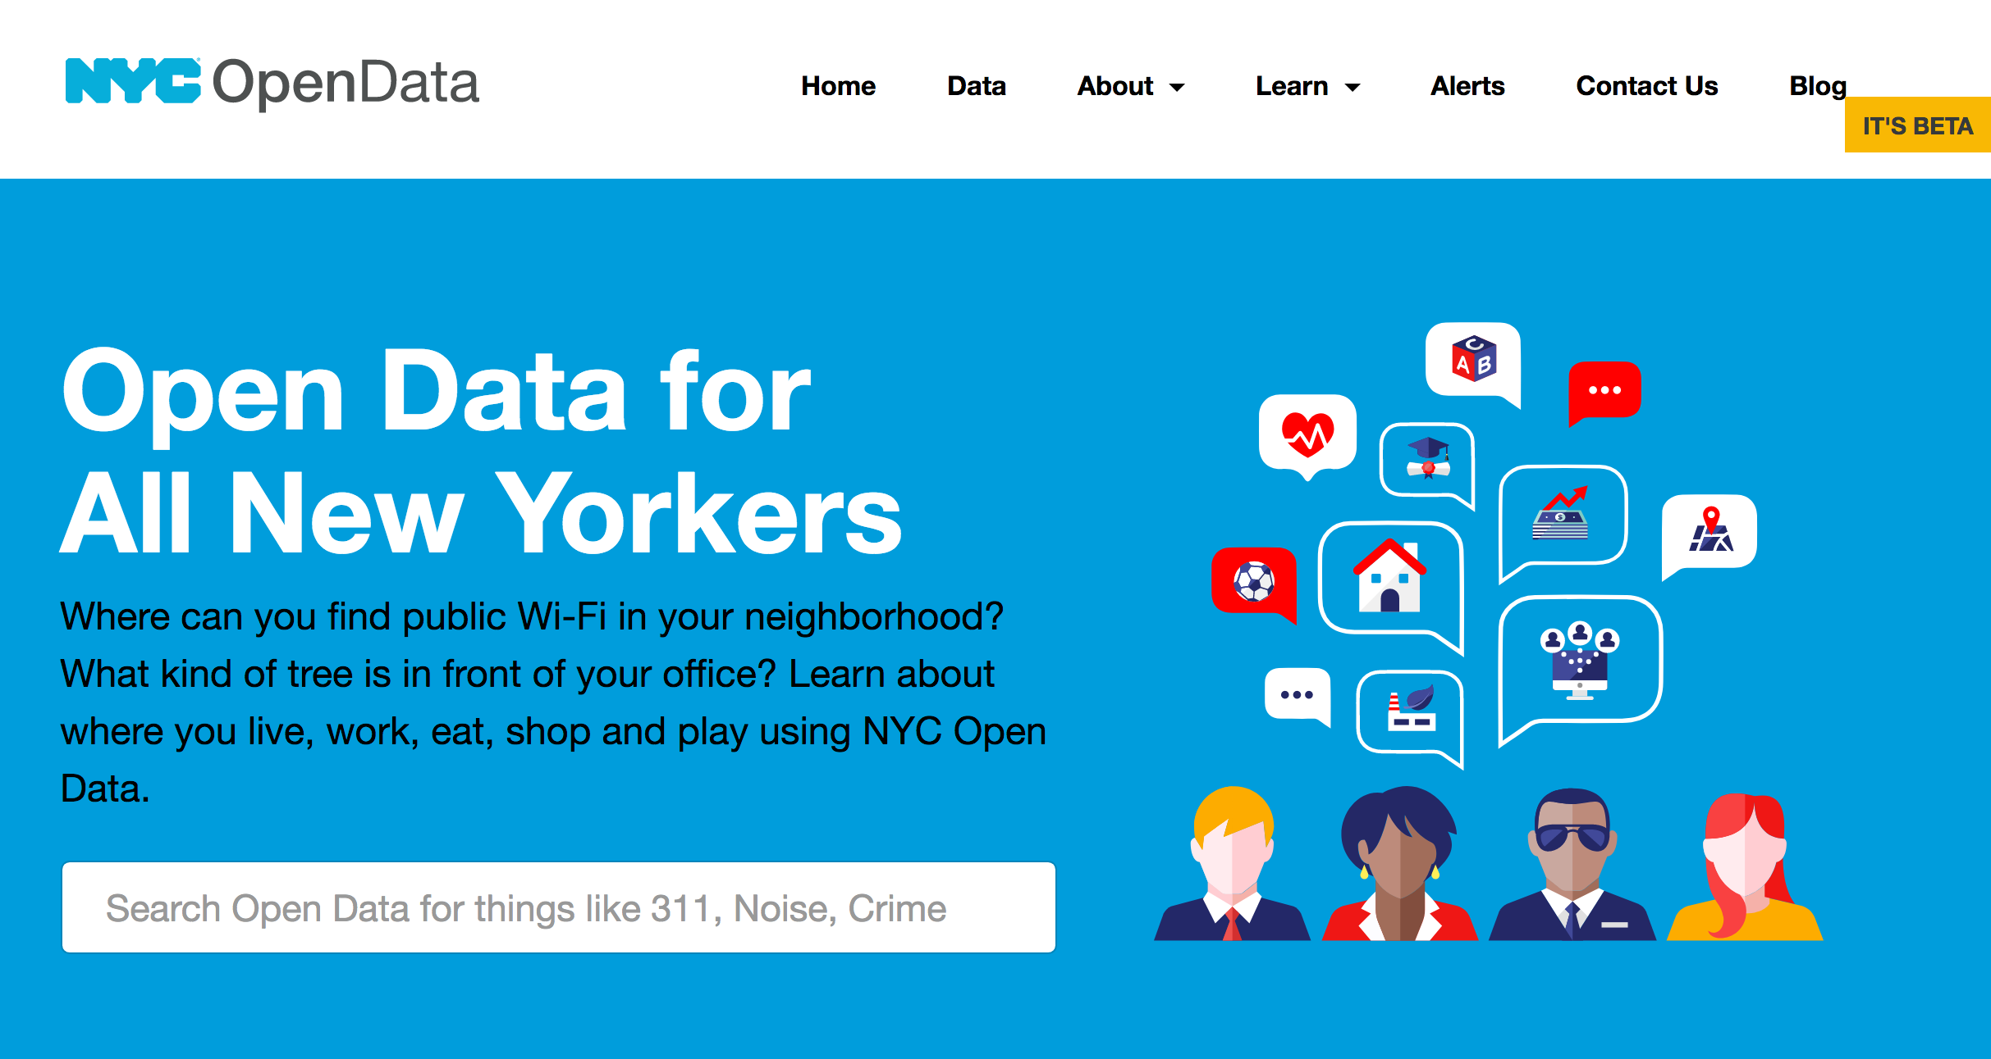
Source:
311 Complaint Database
NYPD Crime Reports

Slide 4
Problems:
The max individual file size for git is 100mb.
Total size of 311 Database for the year: 1 GB+
Paired down the data base to just residential noise: 200mb+
Paired down the data base to the month of April: 8mb
Massive Databases

Slide 5

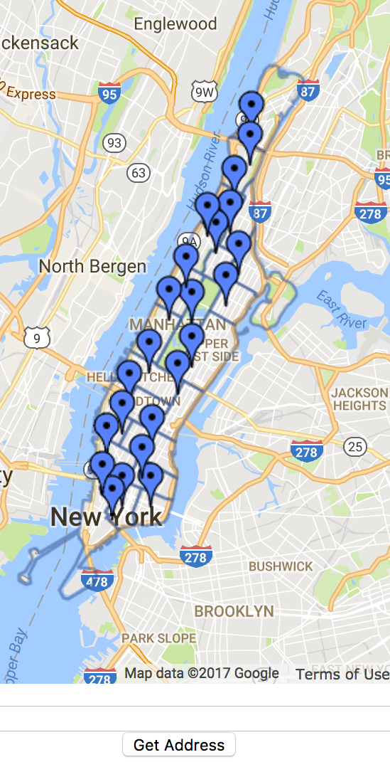
Problems:
Precincts and Zip codes:
I had to manually search zip-codes and enter them into the database.
There wasn’t any databases online linking zip-codes and precincts.

Slide 6
Database manipulation:
By using the value counts algorithm I was able to find the amount of incidents with each zip code and precinct.
Calculated and added in Net Change and Total crimes.

Slide 7
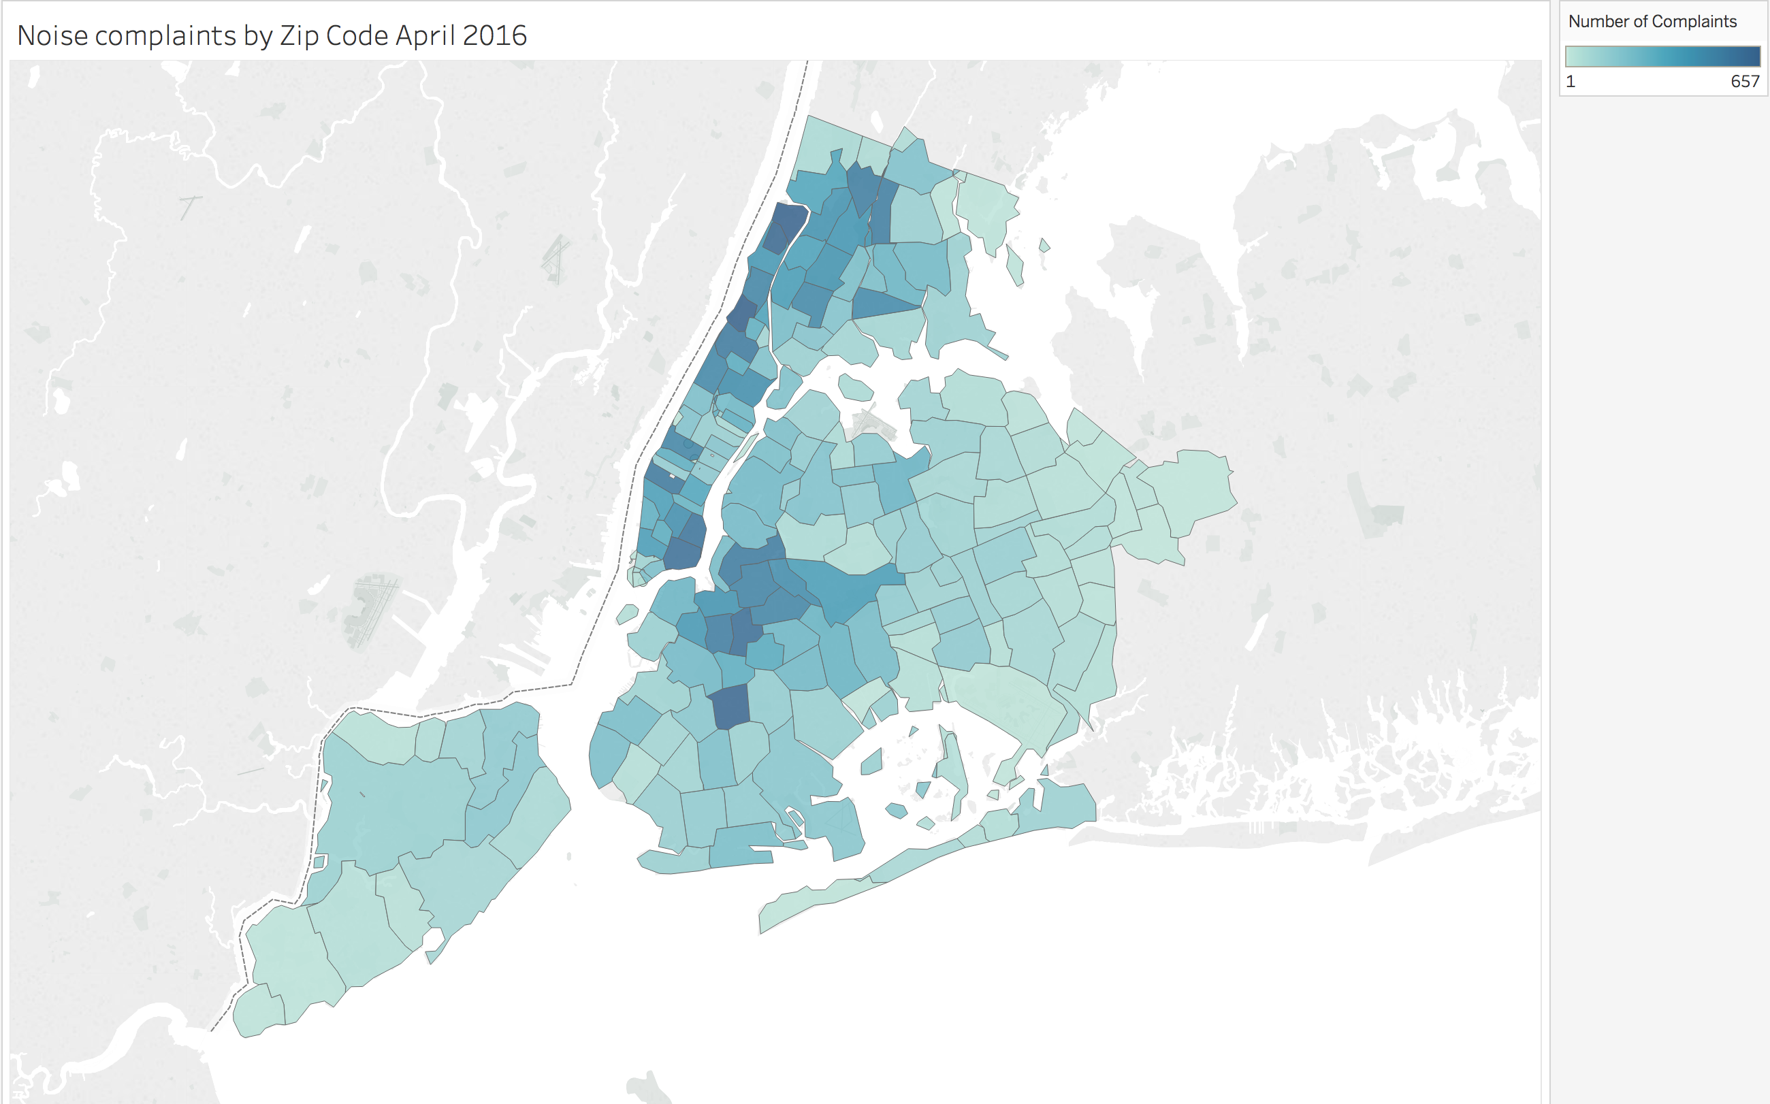
Noise Complaints 2016

Slide 8
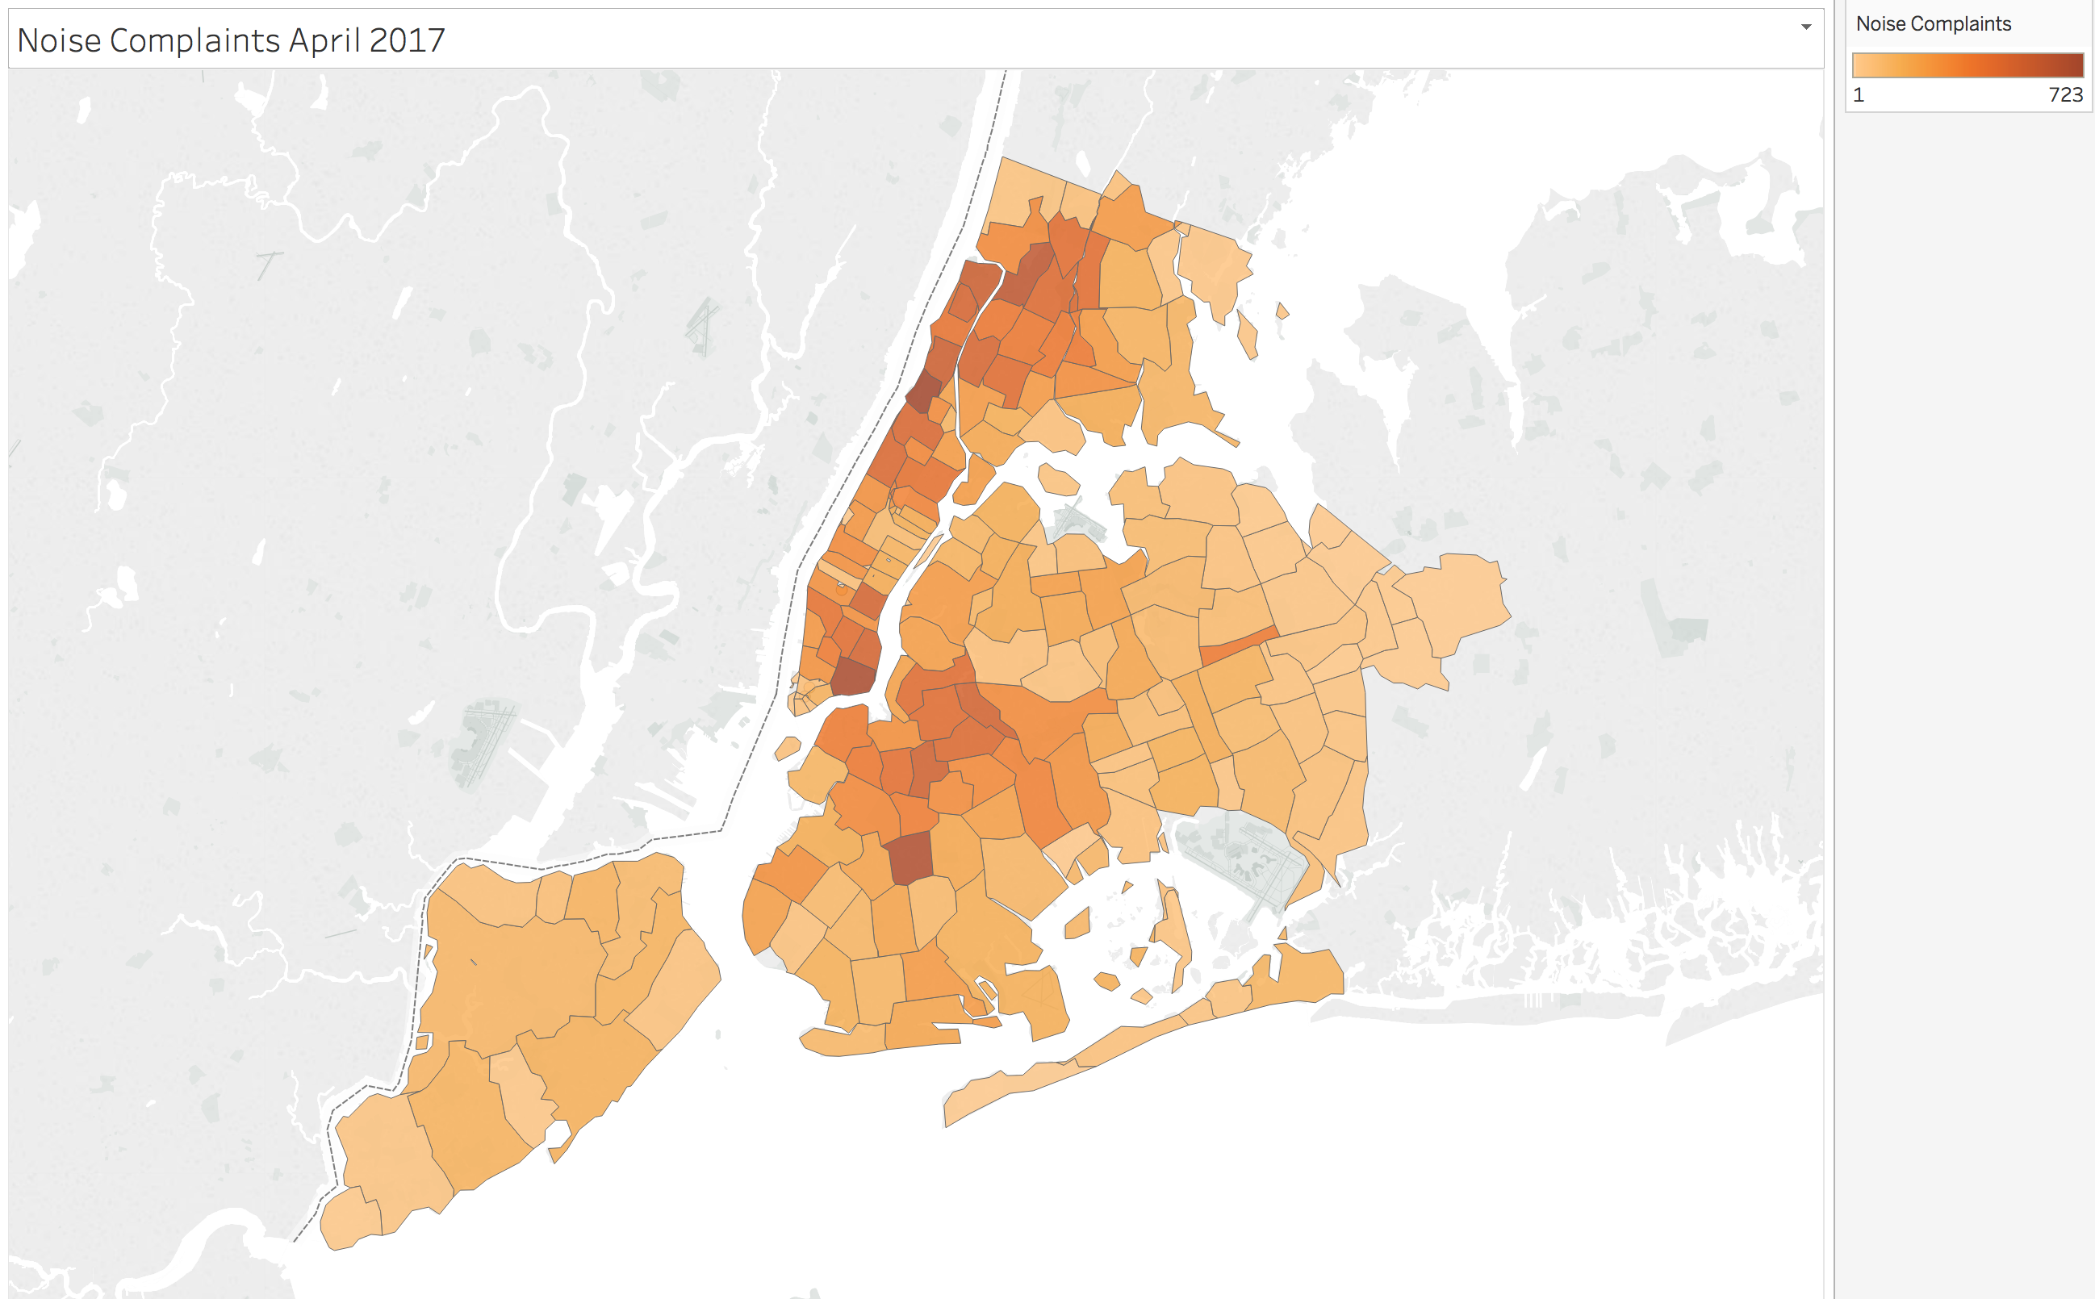
Noise Complaints 2017

Slide 9
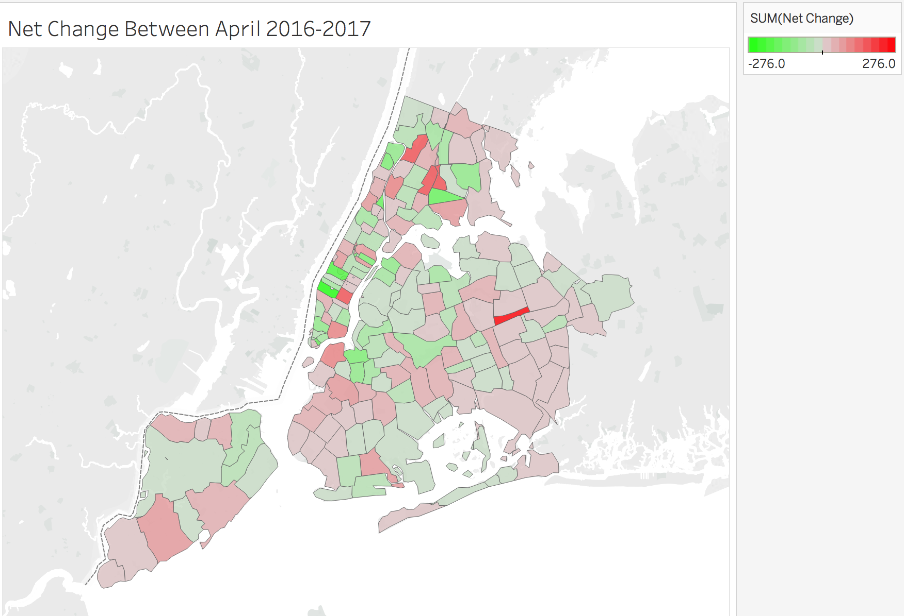
Noise Complaints Net Change

Slide 10
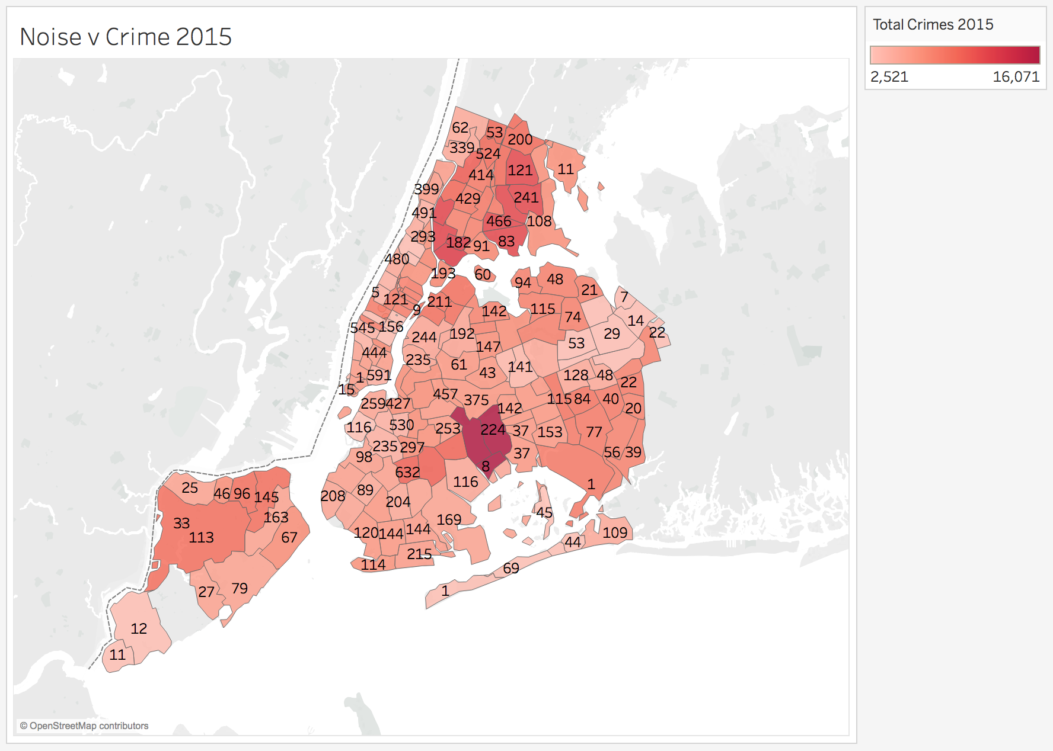
Noise v Crime 2015

Slide 11
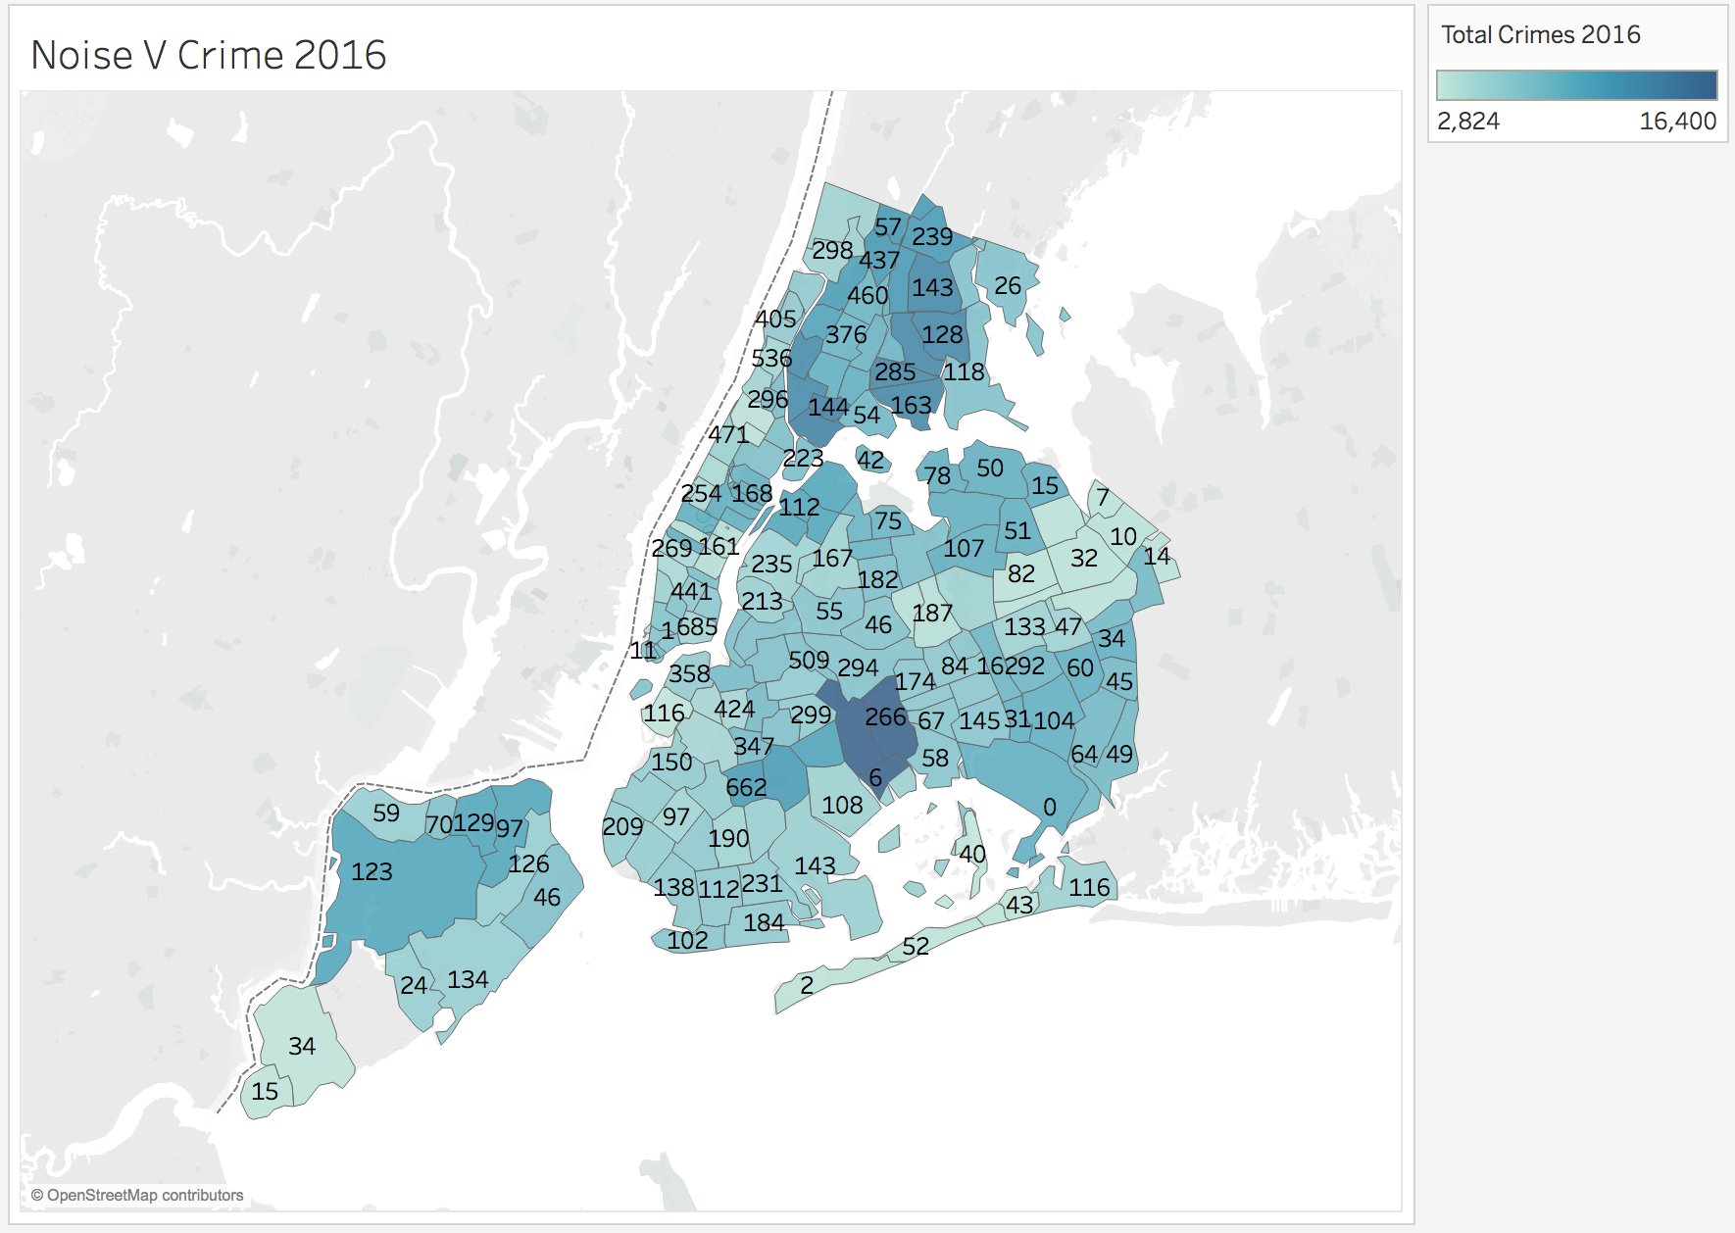
Noise v Crime 2016

Slide 12
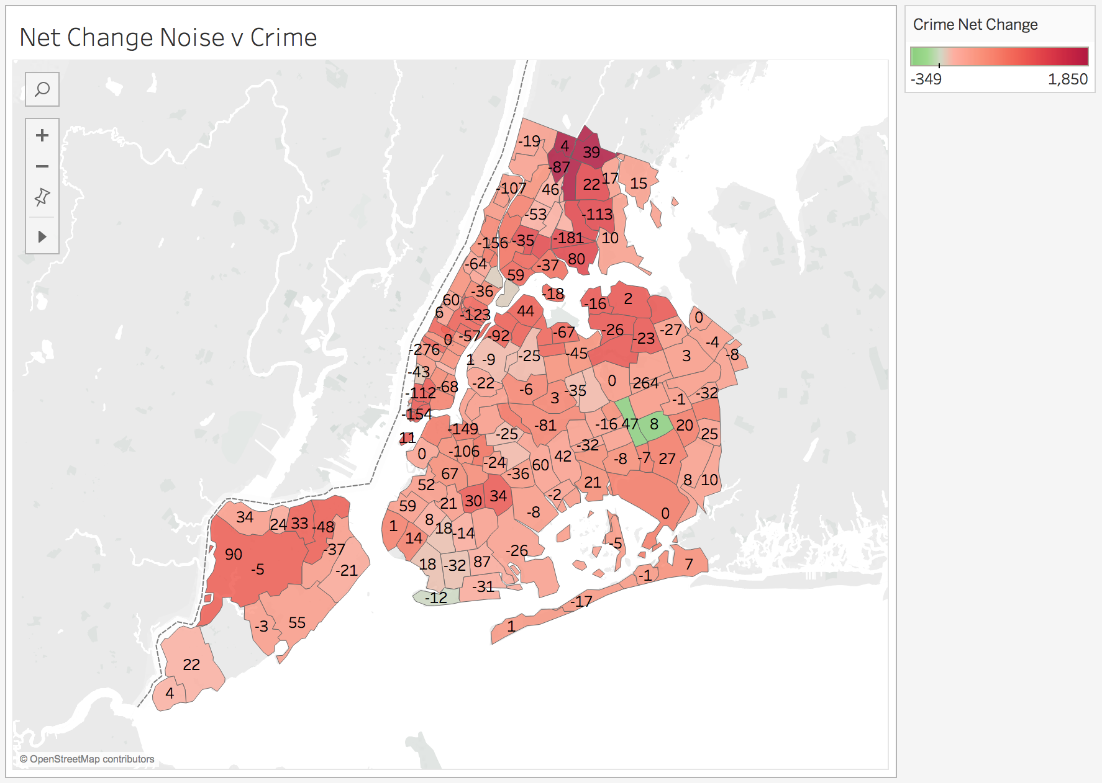
Total Net Change

Slide 13
Conclusions
So, the data was relatively conflicted, it seemed that noise complaints had an inverse relation to criminality of the zip code. Which is interesting, it either means that there needs to be more outreach to the neighborhoods with more crime so they feel like they can make complaints, or the safer neighborhoods are just a bunch of complainers.
I would choose the 10307 zip code because the total number of crimes and noise complaints was the lowest in the city at 15 noise complaints and 4740 reported crimes

